Slide 1

Looping And Grouping A session on good SQL and efficient looping using CFOUTPUT
Gerry Gurevich
Office of Research and Development
National Center for Environmental Assessment
9/29/2012

Slide 2
About Me
Gerry Gurevich
gerry.gurevich@gmail.com
gurevich.gerald@epa.gov
@GerryGurevich
Current Position
Technical Information Specialist, U. S. EPA
Technical Lead for HERO
Previous Work History
Lockheed Martin contracts for EPA and NIEHS
SRA contract for NIEHS
Back to Lockheed Martin contract for EPA

Slide 3
About This Presentation
Beginner
About the CFQUERY tag
About the CFOUTPUT tag
Intermediate
Using Ordering and Grouping
Advanced
Putting more into a query
Getting more out of a loop

Slide 4

A Brief Word About Computer Science V. Computer Engineering
Science
Facts
Truth
Precision
Engineering
Tradeoffs
Truthiness
Good Enough
Application Development Lives Here

Slide 5
Basics
<cfquery
name = "query name“
dataSource = "data source name"
dbtype = "query"
result = "result name" >
sql statement here
</cfquery>

Slide 6

Code Samples
http://localhost/looping/index.cfm
Task Management App
Interrupt and ask questions at any time during this presentation

Slide 7
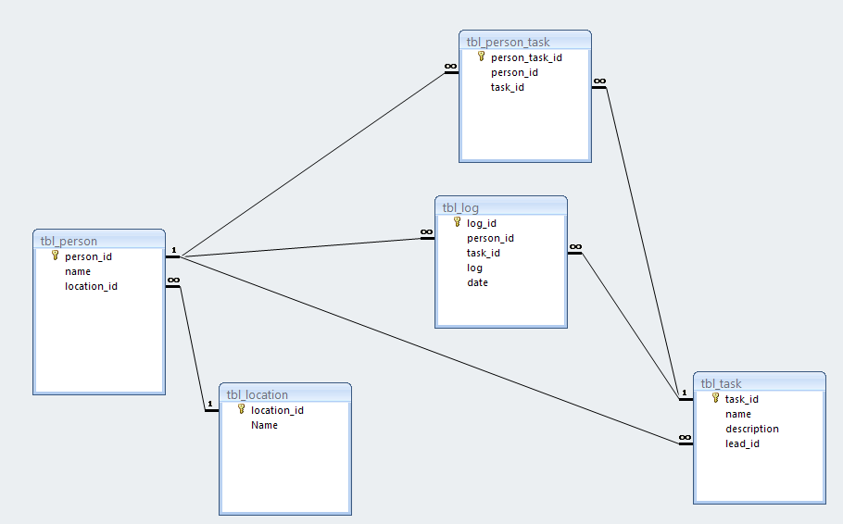

Slide 8
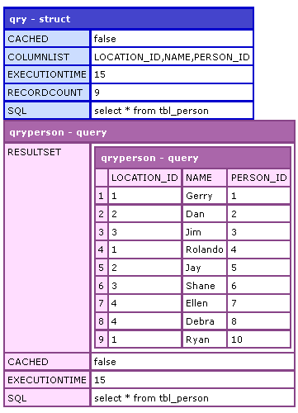
1) A Very Simple Query
<cfquery result="qry"
name= "qryPerson" datasource="#application.dsn#" >
select * from tbl_person
</cfquery>
<cfdump var="#qry#" label="qry" />
<cfdump var="#qryperson#" label="qryperson" />
http://localhost/looping/index.cfm

Slide 9
2) A Better Query
<cfquery name= "qryPerson" datasource="#application.dsn#" >
select
person_id
, name
from
tbl_person
order by
name
</cfquery>
2 -- Dan 8 -- Debra 7 -- Ellen 1 -- Gerry 5 -- Jay 3 -- Jim 4 -- Rolando 10 -- Ryan 6 -- Shane
http://localhost/looping/index.cfm

Slide 10
3) Nested Loops To Build Complex Reports
Bad
Never put a query inside of a loop
Good
Build your queries with joins
Good or Bad?
Never say never (an exception to number 1)
An example of nesting queries in loops
Same as c, but no nesting
http://localhost/looping/index.cfm

Slide 11
4) Building Better Output
Simple Output
Making Bookmarks with <cfsavecontent>
Pagination with query of queries
http://localhost/looping/index.cfm

Slide 12
5) Advanced Queries
Using aggregate functions
Using subselects
http://localhost/looping/index.cfm

Slide 13
Other Query Tags
CFDIRECTORY (index.cfm)
CFSEARCH (Example 6)
CFFTP
<more from the audience….>
http://localhost/looping/index.cfm

Slide 14

My Goal: 4 ½ stars
Source: http://xkcd.com/1098/

Slide 15
Some Good Tools
collapsable.cfm for debugging
http://code.google.com/p/coldfusion-debug/source/browse/trunk/collapsable.cfm?r=26
Clipboard caching tools
clcl
http://www.nakka.com/soft/clcl/index_eng.html
Ethervane echo
http://www.donationcoder.com/forum/index.php?topic=27849.0

